Slide 1
Software Engineering
Wei-Min Wu（吴为民）
School of Petroleum
China University of Petroleum - Beijing at Karamay
Fall, 2025

Slide 2
Chap. 6 Architectural Design
Topics covered 覆盖主题
Architectural design decisions 体系结构设计决策
Architectural views 体系结构视图
Architectural patterns 体系结构模式
Application architectures 应用体系结构（留作自学）

Slide 3
Chap. 6 Architectural Design
Architectural design 体系结构设计
Architectural design is concerned with understanding how a software system should be organized and designing the overall structure of that system. 关注:理解应如何组织软件系统,如何设计系统整体结构
It is critical link between design and requirements engineering, as it identifies the main structural components in a system and the relationships between them. 是设计与需求工程之间的关键环节
The output of the architectural design process is an architectural model that describes how the system is organized as a set of communicating components. 输出: 结构模型，描述了系统如何组织为一组相互通信的构件

Slide 4
Chap. 6 Architectural Design
Agility and architecture 敏捷与体系结构
It is generally accepted that an early stage of an agile development process should focus on designing an overall system architecture. 敏捷开发过程：开发过程早期,应该关注设计一个整体的系统体系结构
Incremental development of architectures is not usually successful. 体系结构的增量式开发通常不成功
Refactoring components in response to changes is usually relatively easy. However, refactoring the system architecture is expensive because you may need to modify most system components to adapt them to the architectural changes. 重构组件相对容易，但重构系统体系结构是昂贵的,因为需要修改大多数组件

Slide 5
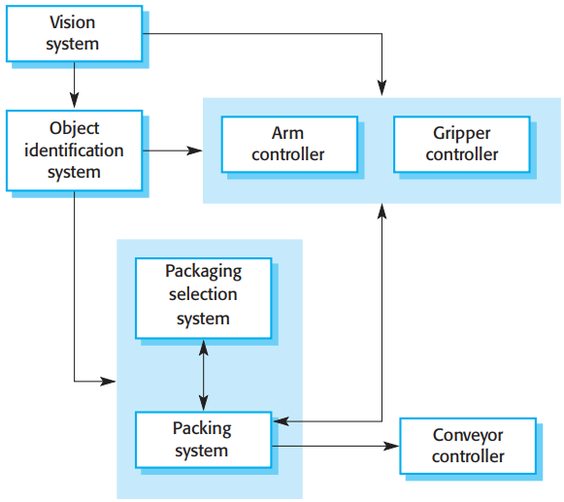

Chap. 6 Architectural Design
The architecture of a packing robot control system
* To understand system architecture, look at Fig. 6.1.
* This diagram shows an abstract model of the architecture for a packing robot system.
* The system can pack different kinds of objects.
* It uses a vision component to pick out objects on a conveyor, identify the type of object, and select the right kind of packaging. The system then moves objects from the delivery conveyor to be packaged. It places packaged objects on another conveyor.
* The architectural model shows these components and the links between them.

Slide 6
Chap. 6 Architectural Design
Architectural abstraction 体系结构抽象
In practice, there is a significant overlap between the processes of requirements engineering and architectural design. 需求工程与体系结构设计的过程有显著重叠
You can design software architectures at two levels of abstraction, 可在两个抽象级别上设计软件体系结构
Architecture in the small: is concerned with the architecture of individual programs. At this level, we are concerned with the way that an individual program is decomposed into components. 小体系结构
Architecture in the large: is concerned with the architecture of complex enterprise systems that include other systems, programs, and program components. These systems are distributed over different computers, owned and managed by different companies. 大体系结构

Slide 7
Chap. 6 Architectural Design
Advantages of explicitly design and document software architecture 明确地设计和文档化体系结构的优势
Stakeholder communication: The architecture is a high-level presentation of the system that may be used as a focus for discussion by a range of different stakeholders. 干系人交流
System analysis: Making the system architecture explicit at early stage requires some analysis. Architectural design decisions have a profound effect on whether or not the system can meet critical requirements such as performance, reliability, and maintainability. 系统分析
Large-scale reuse: The system architecture is often the same for systems with similar requirements and so can support large-scale software reuse. 大规模复用

Slide 8
Chap. 6 Architectural Design
Architectural representations 体系结构表示
System architectures are often modeled informally using simple block diagrams, as in Fig. 6.1. Each box in the diagram represents a component. Boxes within boxes indicate that the component has been decomposed to subcomponents. Arrows mean that data and or control signals are passed from component to component in the direction of the arrows. 非正式建模：简单的框图
Block diagrams can be readily understand and widespread used. However, someone claim that these informal diagrams are poor architectural representations, as they show neither the type of the relationships among system components nor the components’ externally visible properties. 但遭到批评

Slide 9
Chap. 6 Architectural Design
Use of architectural models 体系结构模型的运用
The contradictions between architectural theory and industrial practice arise because there are two ways in which an architectural model is used. 因为体系结构模型有如下两种使用方式，引起体系结构理论与工业实践之间的矛盾
As a way of encouraging discussions about the system design: A high-level architectural view of a system is useful for communication with system stakeholders and project planning because it isn’t cluttered with detail. Stakeholders understand an abstract view of system.作为鼓励讨论系统设计的方式(要求抽象)
As a way of documenting an architecture that has been designed: The aim is to produce a complete system model that shows different components in a system, their interfaces and connections. The argument is that such a detailed architectural description makes it easier to understand and evolve the system. 作为文档化已设计好体系结构的方式(要求详细)

Slide 10
Chap. 6 Architectural Design
6.1 Architectural design decisions 体系结构设计决策
Architectural design is a creative process in which you design a system organization that will satisfy the functional and non-functional requirements of a system.是一个创造性过程,设计系统组织，满足功能/非功能需求
There is no formulaic architectural design process. It depends on the type of system being developed, the background and experience of the system architect, and the specific requirements for the system. 没有公式化的体系结构设计过程，依赖于系统类型、系统架构师的背景和经验、及特定需求
Consequently, it is best to consider architectural design as a series of decisions to be made rather than a sequence of activities. 因此，最好将体系结构设计看成一系列要做的决策而不是一序列的活动

Slide 11

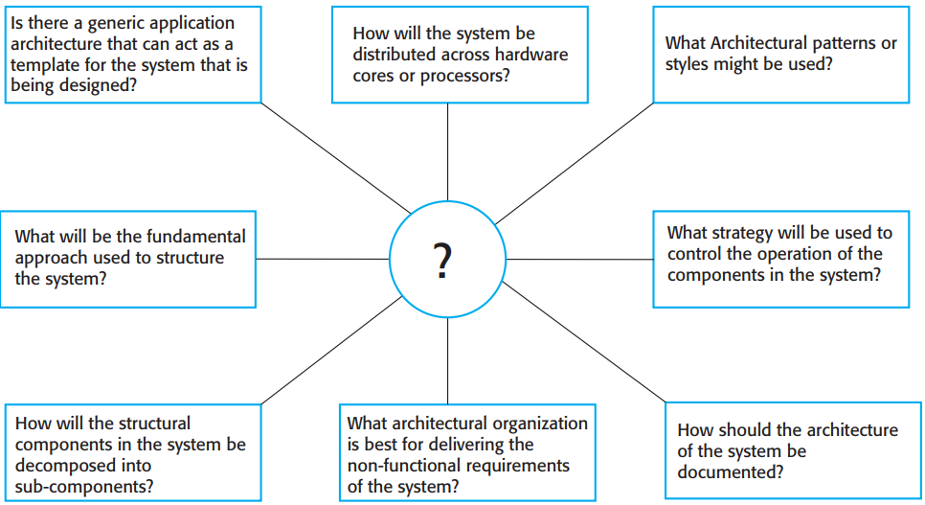
Architecture design decisions
* During the architectural design process, system architects have to make a number of structural decisions that profoundly affect the system and its development process.
* Based on their knowledge and experience, they have to consider the fundamental questions shown in Figure 6.2.

Slide 12
Chap. 6 Architectural Design
Architecture reuse 体系结构复用
Systems in the same application domain often have similar architectures that reflect the fundamental concepts of the domain. For example, application product lines are applications that are built around a core architecture with variants that satisfy specific customer requirements. 相同应用领域的系统通常有类似的体系结构
The architecture of a software system may be based on a particular Architectural pattern or style. Architectural patterns capture the essence of an architecture that has been used in different software systems. You should be aware of common patterns, where they can be used, and their strengths and weaknesses when making decisions about the architecture of a system. 软件系统的体系结构可基于特定的体系结构模式或风格

Slide 13
Chap. 6 Architectural Design
The choice of architectural style and structure should depend on the non-functional requirements of the system because of the close relationship between them: 体系结构风格的选择取决于非功能需求
Performance: Localize critical operations within a small number of components and minimise communications. Use large rather than fine-grain components. 性能
Security: Use a layered architecture, with the most critical assets protected in the innermost layers. 信息安全
Safety: Safety-related operations are co-located in a single component or in a small number of components. 安全性
Availability: Include redundant components so as to replace and update components without stopping the system. 可用性
Maintainability: Use fine-grain, self-contained components that may readily be changed. 可维护性

Slide 14
Chap. 6 Architectural Design
6.2 Architectural views 体系结构视图
Two priblems: ① What views or perspectives are useful when designing and documenting a system’s architecture? ② What notations should be used for describing architectural models? 两个问题: 什么视图或视角是有用的？应该用什么表示法？
A graphical model can only show one view or perspective of the system. It might show how a system is decomposed into modules, how the runtime processes interact, or the different ways in which system components are distributed. Because these are useful at different times, for both design and documentation, you usually need to present multiple views of the software architecture. 一种图形模型只能展示一种视图或视角；通常需要展示软件体系结构的多种视图

Slide 15
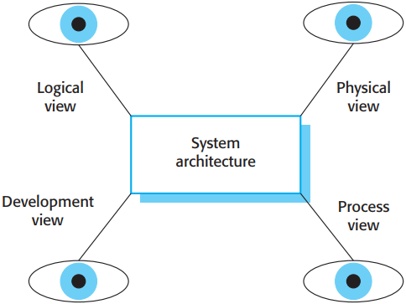

Chap. 6 Architectural Design
Krutchen’s 4+1 view model 4+1视图模型
* There are different opinions as to what views are required.
* Krutchen in his well-known 4+1 view model of software architecture, suggests that there should be four fundamental architectural views, which can be linked through common use cases or scenarios (Figure 6.3).

Slide 16
Chap. 6 Architectural Design
4 + 1 view model 4+1视图模型
A logical view, which shows the key abstractions in the system as objects or object classes. It is possible to relate the system requirements to entities in this view. 逻辑视图
A process view, which shows how, at runtime, the system is composed of interacting processes. It is useful for making judgments about non-functional characteristics. 进程视图
A development view, which shows how the software is decomposed for development; This view is useful for software managers and programmers. 开发视图
A physical view, which shows the system hardware and how software components are distributed across the processors in the system. This view is useful for systems engineers planning a system deployment. 物理视图
Related using use cases or scenarios (+1) 以用例或场景联系

Slide 17
Chap. 6 Architectural Design
Representing architectural views 表示体系结构视图
There are differing views about whether or not software architects should use UML for describing and documenting software architectures. The UML was for describing object-oriented systems, but at architectural design, you often want to describe systems at a higher level of abstraction. 是否使用UML来描述和文档软件化体系结构：观点不同
Some researchers propose to use more specialized ADL (architectural description languages) to describe system architectures. Since ADLs are specialist languages, domain and application specialists find it hard to understand and use ADLs. 使用更专业化的体系结构描述语言：难以理解和使用
Agile Users: Except for critical systems, it isn’t worth developing a detailed architectural description from Krutchen’s four perspectives. 敏捷方法:除非是关键系统，开发详细描述不值得的

Slide 18
Chap. 6 Architectural Design
6.3 Architectural patterns 体系结构模式
The idea of patterns as a way of presenting, sharing, and reusing knowledge about software systems has been adopted in a number of areas of software engineering. 模式的思想在SE各领域中采用
Architectural pattern is a stylized, abstract description of good practice, which has been tried and tested in different systems and environments.含义：好的实践的风格化、抽象化描述
It should include information on when it is and is not appropriate to use that pattern, and details on the pattern’s strengths and weaknesses. 应包含：何时适合/不适合，优缺点
* e.g. Fig. 6.4 describes MVC pattern. It is basis of interaction management in many web-based systems and is supported by most language frameworks.

Slide 19
Chap. 6 Architectural Design
MVC(Model-View-Controller) pattern 模型-视图-控制器模式
Name | MVC (Model-View-Controller)
Description | Separates presentation and interaction from the system data. The system is structured into three logical components that interact with each other. The Model component manages the system data and associated operations on that data. The View component defines and manages how the data is presented to the user. The Controller component manages user interaction (e.g., key presses, mouse clicks, etc.) and passes these interactions to the View and the Model. See Figure 6.5.
Example | Figure 6.6 shows the architecture of a web-based application system organized using the MVC pattern.
When used | Used when there are multiple ways to view and interact with data. Also used when the future requirements for interaction and presentation of data are unknown.
Advantages | Allows the data to change independently of its representation and vice versa. Supports presentation of the same data in different ways, with changes made in one representation shown in all of them.
Disadvantages | May involve additional code and code complexity when the data model and interactions are simple.

Slide 20
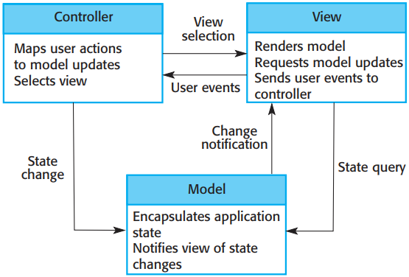

Chap. 6 Architectural Design
The organization of the MVC MVC组织
* These present the architecture from different views: Fig. 6.5 is a conceptual view

Slide 21
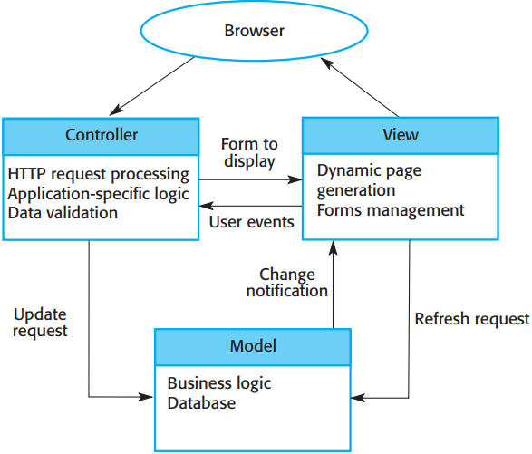

Chap. 6 Architectural Design
Web application architecture using the MVC pattern 使用MVC模式的Web应用体系结构
* These present the architecture from different views: Fig. 6.6 shows a runtime system architecture when this pattern is used for interaction management in a web-based system.

Slide 22
Chap. 6 Architectural Design
Layered architecture 分层体系结构
The system functionality is organized into separate layers, each layer only relies on the facilities and services offered by the layer immediately beneath it. 系统功能分层组织,每层只依赖于紧邻的下一层提供的设施和服务
This layered approach supports the incremental development of systems. some services provided by a developed layer are made available to users. 支持增量式开发
The architecture is also changeable and portable. If its interface is unchanged, a new layer with extended functionality can replace an existing layer; when interfaces change, only the adjacent layer is affected. 可变和可移植
As layered systems localize dependencies, this makes it easier to provide multi-platform implementations of an application system. Only the machine-dependent layers need be reimplemented. 依赖局部化,使多平台实现容易

Slide 23
Chap. 6 Architectural Design
The Layered architecture pattern 分层体系结构模式
Name | Layered architecture
Description | Organizes the system into layers with related functionality associated with each layer. A layer provides services to the layer above it so the lowest level layers represent core services that are likely to be used throughout the system. See Figure 6.8.
Example | A layered model of a digital learning system to support learning of all subjects in schools (Figure 6.9).
When used | Used when building new facilities on top of existing systems; when the development is spread across several teams with each team responsibility for a layer of functionality; when there is a requirement for multi-level security.
Advantages | Allows replacement of entire layers so long as the interface is maintained. Redundant facilities (e.g., authentication) can be provided in each layer to increase the dependability of the system.
Disadvantages | In practice, providing a clean separation between layers is often difficult and a high-level layer may have to interact directly with lower-level layers rather than through the layer immediately below it. Performance can be a problem because of multiple levels of interpretation of a service request as it is processed at each layer.

Slide 24
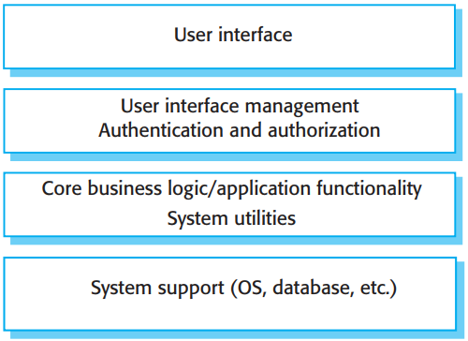

Chap. 6 Architectural Design
A generic layered architecture 一般的分层体系结构
* Figure 6.8 is an example of a layered architecture with four layers. The lowest layer includes system support software—typically, database and operating system support.
* The next layer is the application layer, which includes the components concerned with the application functionality and utility components used by other application components.
* The third layer is concerned with user interface management and providing user authentication and authorization, with the top layer providing user interface facilities.
* Of course, the number of layers is arbitrary. Any of the layers in Figure 6.8 could be split into two or more layers.

Slide 25
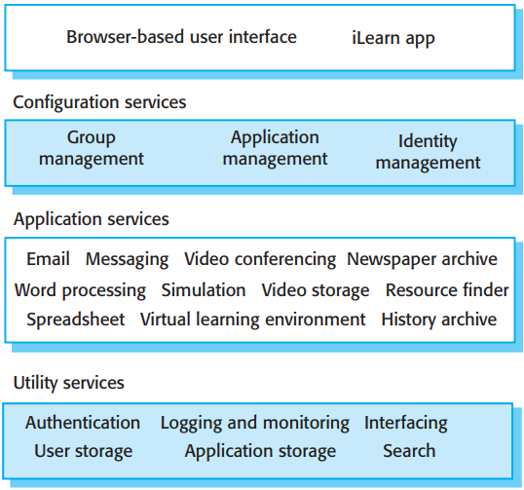

Chap. 6 Architectural Design
The architecture of the iLearn system 例子
*Figure 6.9 shows that the iLearn digital learning system, has a four-layer architecture that follows this pattern.
* You can see another example of the Layered Architecture pattern in Figure 6.19 (Section 6.4, which shows the organization of the Mentcare system.

Slide 26
Chap. 6 Architectural Design
Repository architecture 仓储体系结构
The Repository pattern (Fig. 6.10), describes how a set of interacting components can share data. The majority of systems that use large amounts of data are organized around a shared database or repository. 含义
Fig. 6.11 shows a situation in which a repository might be used. This diagram shows an IDE that includes different tools to support model-driven development. The repository might be a version-controlled environment (see Chapter 25) that keeps track of changes to software and allows rollback to earlier versions. 例子:IDE(集成开发环境)
Organizing tools around a repository is an efficient way of sharing large amounts of data. no need to transmit data explicitly from one component to another. 围绕仓储来组织工具是共享大量数据的有效方式

Slide 27

Chap. 6 Architectural Design
The Repository pattern 仓库模式
Name | Repository
Description | All data in a system is managed in a central repository that is accessible to all system components. Components do not interact directly, only through the repository.
Example | Figure 6.11 is an example of an IDE where the components use a repository of system design information. Each software tool generates information which is then available for use by other tools.
When used | You should use this pattern when you have a system in which large volumes of information are generated that has to be stored for a long time. You may also use it in data-driven systems where the inclusion of data in the repository triggers an action or tool.
Advantages | Components can be independent; they do not need to know of the existence of other components. Changes made by one component can be propagated to all components. All data can be managed consistently (e.g., backups done at the same time) as it is all in one place.
Disadvantages | The repository is a single point of failure so problems in the repository affect the whole system. May be inefficiencies in organizing all communication through the repository. Distributing the repository across several computers may be difficult.

Slide 28
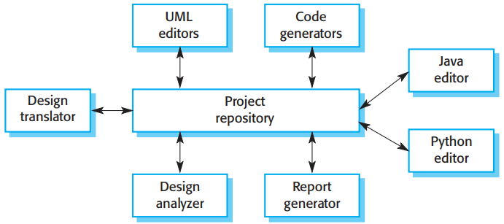

Chap. 6 Architectural Design
A repository architecture for an IDE
*Components must operate around an agreed repository data model.
* In practice, it may be difficult to distribute the repository over a number of machines. Although it is possible to distribute a logically centralized repository, this involves maintaining multiple copies of data. Keeping these consistent and up to date adds more overhead to the system.

Slide 29
Chap. 6 Architectural Design
Client-server architecture 客户机-服务器体系结构
The Client–Server pattern (Fig. 6.12), illustrates a commonly used runtime organization for distributed systems. A system is organized as a set of services and associated servers, and clients that access and use the services. 系统组织为一组服务及相关的服务器,客户访问并使用服务
The major components of this model are: 主要构件
A set of servers that offer services to other components.
A set of clients that call on the services offered by servers.
A network that allows the clients to access these services.
Clients may have to know the names of available servers and the services they provide. However, servers do not need to know the identity of clients or how many clients are accessing their services. 客户需要知道服务器及服务，服务器无需知道客户

Slide 30

Chap. 6 Architectural Design
The Client–server pattern 客户机-服务器模式
Name | Client-server
Description | In a client–server architecture, the system is presented as a set of services, with each service delivered by a separate server. Clients are users of these services and access servers to make use of them.
Example | Figure 6.13 is an example of a film and video/DVD library organized as a client–server system.
When used | Used when data in a shared database has to be accessed from a range of locations. Because servers can be replicated, may also be used when the load on a system is variable.
Advantages | The principal advantage of this model is that servers can be distributed across a network. General functionality (e.g., a printing service) can be available to all clients and does not need to be implemented by all services.
Disadvantages | Each service is a single point of failure so susceptible to denial-of-service attacks or server failure. Performance may be unpredictable because it depends on the network as well as the system. management problems may arise if servers are owned by different organizations.

Slide 31
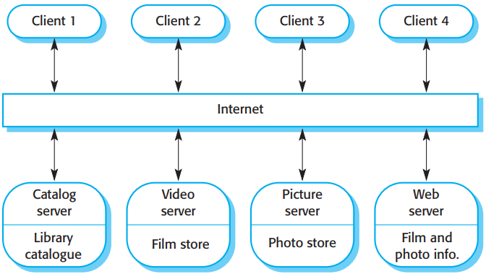
Chap. 6 Architectural Design
A client–server architecture for a film library 电影库的客户机-服务器体系结构
* Fig. 6.13 A system that is based on client–server model.
* A multiuser, web-based system for providing a film and photograph library.
*Several servers manage and display the different types of media. Video frames need to be transmitted quickly and in synchrony but at relatively low resolution. They may be compressed in a store, so the video server can handle video compression and decompression in different formats; Still pictures, however, must be maintained at a high resolution, so it is appropriate to maintain them on a separate server.
* The catalog must be able to deal with a variety of queries and provide links into the web information system that include data about the film and video clips, and an e-commerce system that supports the sale of photographs, film, and video clips. The client program is simply an integrated user interface, constructed using a web browser, to access these services.

Slide 32
Chap. 6 Architectural Design
Pipe and filter architecture 管道-过滤器体系结构
Pipe and Filter pattern (Fig. 6.14) is a model of the runtime organization of a system where functional transformations process inputs and produce outputs. Data flows from one to another and is transformed as it moves through the sequence. 功能转换:处理输入,产生输出
The name “pipe and filter” comes from the original Unix system. 名字来自Unix
Variants of this pattern have been very common. When transformations are sequential and in batchs, this model becomes a batch sequential model, a common architecture for data-processing systems. The architecture of an embedded system may also be organized as a process pipeline, with each process executing concurrently. 该模式的变体很常用
Interactive systems are difficult to write using the pipe and filter model. 交互式系统不适合用该模式

Slide 33

Chap. 6 Architectural Design
The pipe and filter pattern 管道-过滤器模式
Name | Pipe and filter
Description | The processing of the data in a system is organized so that each processing component (filter) is discrete and carries out one type of data transformation. The data flows (as in a pipe) from one component to another for processing.
Example | Figure 6.15 is an example of a pipe and filter system used for processing invoices.
When used | Commonly used in data-processing applications (both batch and transaction-based) where inputs are processed in separate stages to generate related outputs.
Advantages | Easy to understand and supports transformation reuse. Workflow style matches the structure of many business processes. Evolution by adding transformations is straightforward. Can be implemented as either a sequential or concurrent system.
Disadvantages | The format for data transfer has to be agreed upon between communicating transformations. Each transformation must parse its input and unparse its output to the agreed form. This increases system overhead and may mean that it is impossible to reuse architectural components that use incompatible data structures.

Slide 34

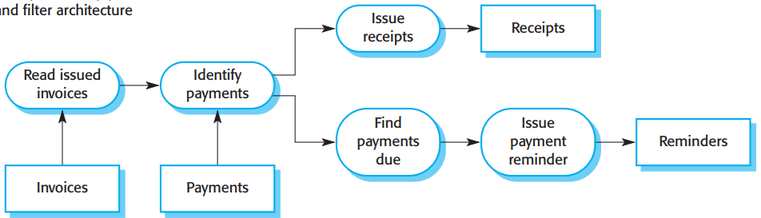
Chap. 6 Architectural Design
Example: The pipe and filter architecture used in a payments system 例子:支付系统的管道-过滤器体系结构
* An example of this type of system architecture, used in a batch processing application, is shown in Figure 6.15.
* An organization has issued invoices to customers. Once a week, payments that have been made are reconciled with the invoices. For those invoices that have been paid, a receipt is issued. For those invoices that have not been paid within the allowed payment time, a reminder is issued.

Slide 35
Chap. 6 Architectural Design
6.4 Application architectures (本节留作自学)

